Slide 1

LECTURE 1: ADMINISTRATIVE ISSUES

Slide 2
Introduction
Mr. Daniel Njeru
Email Address: daniel.njeru@zetech.ac.ke
Phone number: +254719321351
Unit Code:
BSD 411
Unit Name
BUSINESS INTELLIGENCE AND ANALYTICS

Slide 3
Introduction
Class Representative- Done? Volunteers?
Groups’ Formation- No need for groups
Two assignments to be done in groups

Slide 4
Course Purpose
To evaluate strategic use of BI technology for strategic advantage, and to provide practical understanding of the BI concepts and technologies in business organizations.

Slide 5
Key Course Objectives
By the end of the course unit a student shall be able to:
Apply theoretical concepts of the course to the decision-making and BI processes and technologies for making appropriate managerial decisions in future real-life situations.
Undertake systematic investigation/research related to the decision support and BI systems and technologies for today’s dynamic business environment.
Develop professional attitudes in students in relation to team work, interpersonal communication, and business ethics

Slide 6
Course Structure
3HRS of class lectures and Practical Sessions Per week.
Teaching methodology
Class Lectures, Discussions Forums, Class Presentations
Case analysis, discussion and presentations
Active participation required

Slide 7
What’s the Lecturer’s Job?
Provide an environment in which students can actively learn practical skills and knowledge necessary to meet the set objectives
Provide an in-depth of concepts relating to Business intelligence and Data analytics assuming there is no prior knowledge acquired by the learners
Have an open office hours- Every Thursday and Friday in Mangu Campus

Slide 8
Course References
Lecture notes
Extra Sources Provided
Internet sources
Course Books:
Albright, S. C., & Winston, W. L. (2020). Business analytics: Data analysis & decision making. Cengage Learning.
Sharda, R., Delen, D., & Turban, E. (2016). Business intelligence, analytics, and data science: a managerial perspective. Pearson.
Text books for further reading
Sabherwal, R., & Becerra-Fernandez, I. (2013). Business intelligence: practices, technologies, and management. John Wiley & Sons.
Sauter, V. L. (2014). Decision support systems for business intelligence. John Wiley & Sons.
Efraim, T. (2011). Decision support and business intelligence systems. Pearson Education India.

Slide 9
Assignments, CATs and Final Examination
Assessment (Tentative)
Two CATs 20%
Assignment One 5%
Case Analysis Assignment 5%
Final Exam 70%
Total 100%
Late Submission Rule (LSR): 10% per day off (One week grace period!!)

Slide 10
COURSE SYLLABUS AND SCHEDULE
WEEK | TOPIC | SUB TOPIC | DELIVERABLES
Week 1 | Administrative Issues and Introduction | Administrative Issues Introduction to Data, warehousing and Business intelligence Concepts Definitions Tools in Data and Data Analytics in the 21st Century Introduction to Business Intelligence | Set the course objectives
Week 2 | Introduction to Business Intelligence and Business analytics | Market Basket Analysis Descriptive, Predictive, and Prescriptive Analytics Analytics Lifecycle: Define, Collect, Analyze, Interpret, and Act Role of Machine Learning in Analytics Key Metrics and KPIs for Business Analytics
Week 3 | Data Management Best Practices | Data Wrangling Best Practices to implement BI projects Data story-telling concepts and use cases The role of Data Science in business Introduction to Cloud Based BI Tools Data Governance and Master Data Management | Assignment 1

Slide 11
COURSE SYLLABUS AND SCHEDULE
WEEK | TOPIC | SUB TOPIC | DELIVERABLES
Week 4 | Big Data and BI | Definition and Characteristics of Big Data (Volume, Velocity, Variety, Veracity) Big Data Technologies: Hadoop, Spark, NoSQL Databases The Role of Big Data in Business Intelligence Challenges of Managing and Analyzing Big Data Big Data Analytics and Use Cases | Assignment 1 due
Week 5 | Using BI to Improve Organizational Performance | The role of business processes Becoming Data Driven Defining Winning KPIs Approach to Implementation (KPIs)
Week 6 | Big Data Fundamentals | Big Data Introduction Big Data Technology Drivers and Enablers for Big Data Hadoop Ecosystems No SQL Fundamentals
CAT ONE

Slide 12
COURSE SYLLABUS AND SCHEDULE
WEEK | TOPIC | SUB TOPIC | DELIVERABLES
Week 4 | Big Data and BI | Definition and Characteristics of Big Data (Volume, Velocity, Variety, Veracity) Big Data Technologies: Hadoop, Spark, NoSQL Databases The Role of Big Data in Business Intelligence Challenges of Managing and Analyzing Big Data Big Data Analytics and Use Cases | Assignment 1 due
Week 5 | Using BI to Improve Organizational Performance | The role of business processes Becoming Data Driven Defining Winning KPIs Approach to Implementation (KPIs)
Week 6 | Big Data Fundamentals | Big Data Introduction Big Data Technology Drivers and Enablers for Big Data Hadoop Ecosystems No SQL Fundamentals
CAT ONE

Slide 13
COURSE SYLLABUS AND SCHEDULE
WEEK | TOPIC | SUB TOPIC | DELIVERABLES
Week 7 | Data Visualization and Reporting | Importance of Data Visualization Principles of Effective Visualizations (Clarity, Accuracy, Efficiency) BI Tools for Visualization: Tableau, Power BI, Google Data Studio Types of Visualizations (Charts, Dashboards, Heatmaps, etc.) Storytelling with Data | Assignment 2
Week 7 | Hands-on Session | Hands-on Session, Data Visualization using Power-BI and Tableau
Week 8 | Predictive Analytics and Machine Learning in BI | Basics of Predictive Modeling Common Machine Learning Algorithms: Regression, Classification, Clustering Supervised vs Unsupervised Learning Use Cases of Predictive Analytics in Business Challenges and Best Practices for Implementing Predictive Analytics

Slide 14
COURSE SYLLABUS AND SCHEDULE
WEEK | TOPIC | SUB TOPIC
Week 9 | BI System Development and Implementation | Phases of BI System Development BI Tools: Commercial (SAP, Oracle, Microsoft BI) vs Open Source (Pentaho, KNIME) BI Implementation Strategies and Challenges Data Integration Techniques Case Studies of Successful BI Implementations
Week 10 | Case Study Analysis | Business Case Analysis on use of BI Systems in the following sectors: Education sector Government Sector Agricultural Sector Finance Sector Non-Governmental Organizations E-commerce business
 | CAT 2 Business Case analysis on Application of Big Data in the Industry
Week 12 | Ethical and Privacy Considerations in BI | Data Privacy Regulations: GDPR, HIPAA, and Others Ethical Issues in Data Analytics and BI Ensuring Transparency and Fairness in AI-Driven BI Balancing Data Security with Business Intelligence Needs Case Studies on Ethical Challenges in BI

Slide 15
COURSE SYLLABUS AND SCHEDULE
WEEK | TOPIC | SUB TOPIC | DELIVERABLES
Week 13 | Emerging Trends in Business Intelligence | Artificial Intelligence and BI Self-Service BI Cloud-Based BI Solutions Augmented Analytics and Automated Insights Natural Language Processing (NLP) in BI
REVISION WEEK
Week 15 and 16 | END OF SEMESTER EXAMS

Slide 16


Slide 17
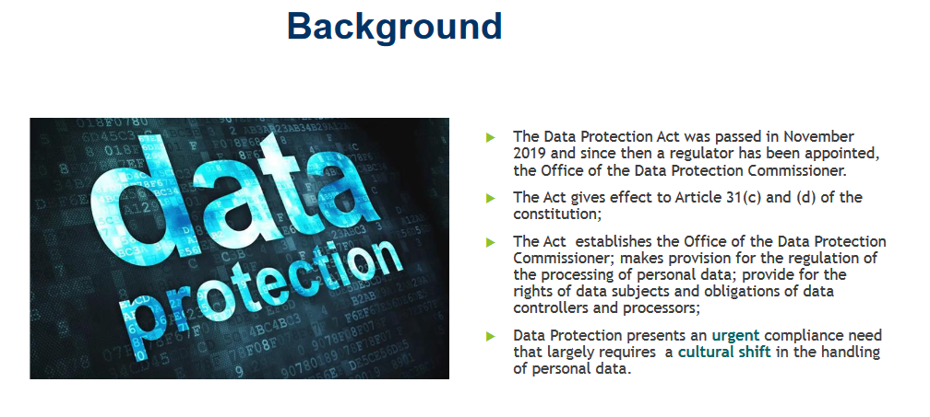
INTRODUCTIONS

Slide 18

INTRODUCTIONS

Slide 19
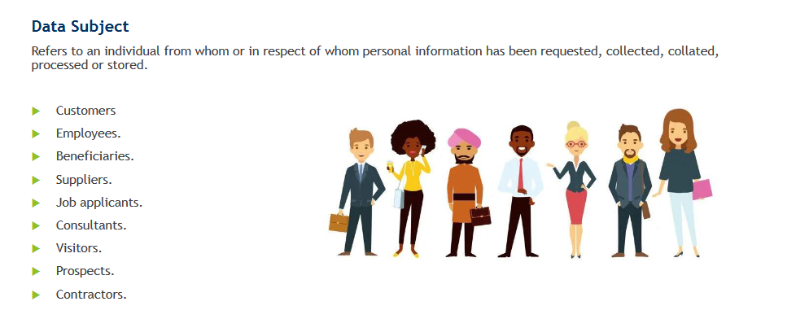
INTRODUCTIONS

Slide 20
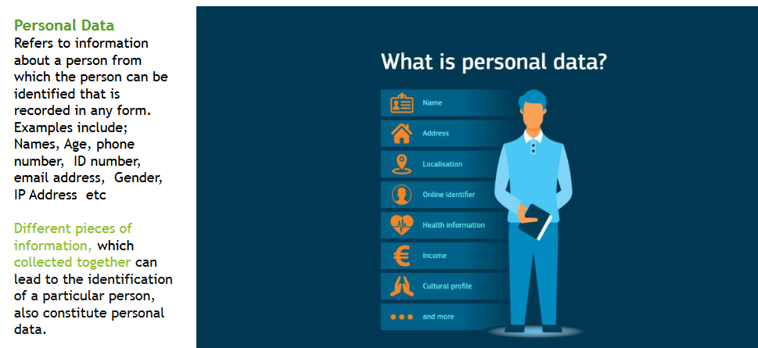
INTRODUCTIONS

Slide 21
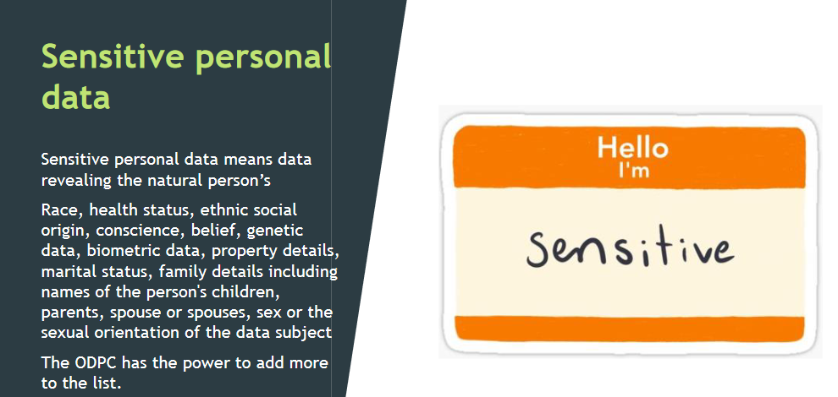
INTRODUCTIONS

Slide 22
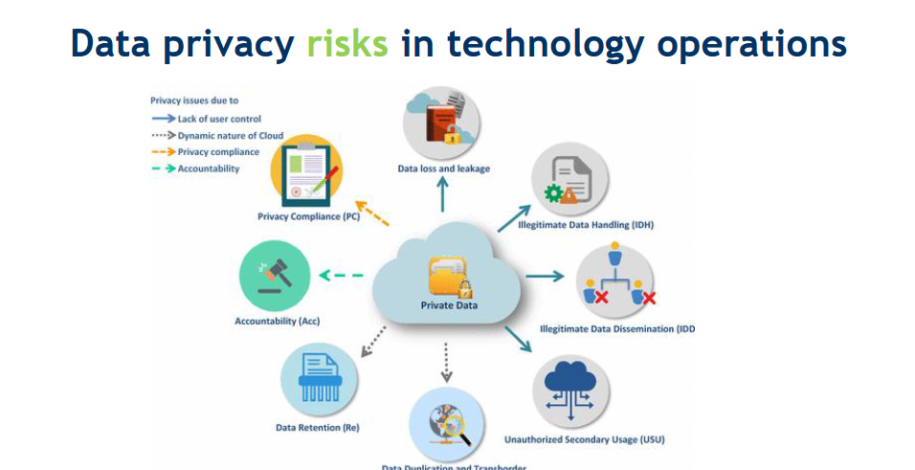
INTRODUCTIONS

Slide 23
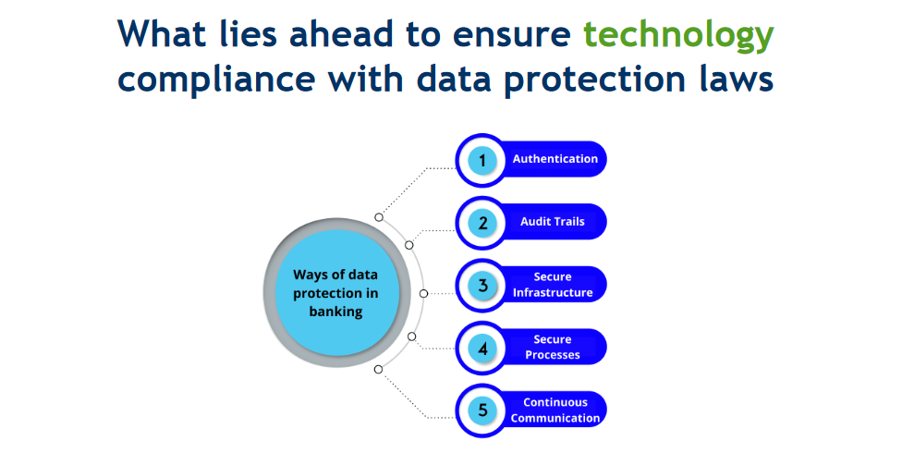
INTRODUCTIONS

Slide 24
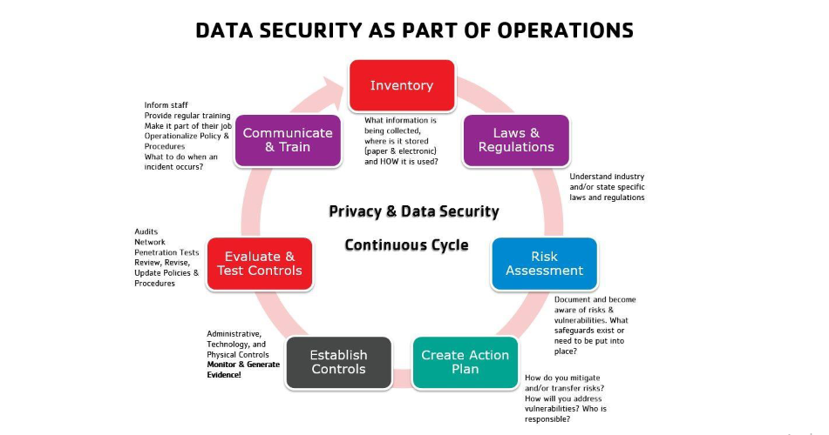
INTRODUCTIONS

